Slide 1
Dynamic Programming
By Shreyas Peddi

Slide 2
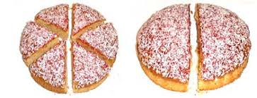
What is Dynamic Programming?
“ Dynamic programming is a technique to solve problems by breaking it down into a collection of sub-problems and solving each of those sub-problems ”

Slide 3
What is Dynamic Programming?
“ Dynamic programming is a technique to solve problems by breaking it down into a collection of sub-problems and solving each of those sub-problems ”
sub-problems
Main problem

Slide 4
Properties of Dynamic Programming
How to recognize a problem that can be solved using dynamic programming?

Slide 5
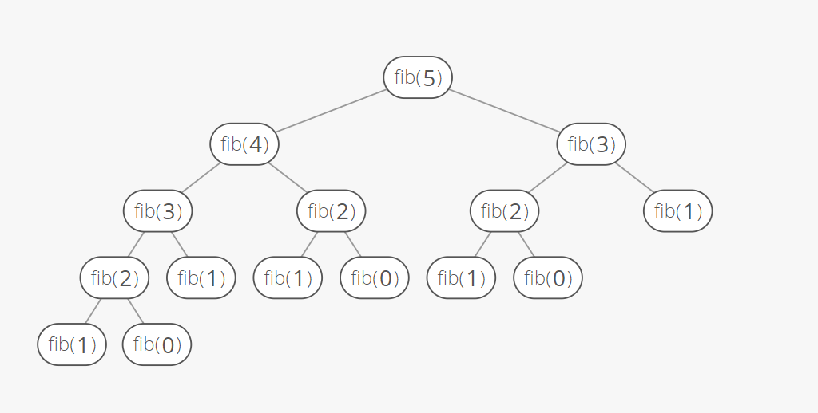
Properties of Dynamic Programming
Overlapping Solutions: solutions of the same sub-problems are needed again and again (recursive)
Inefficient if same sub-problem is computed multiple times

Slide 6
Properties of Dynamic Programming
Overlapping Solutions: solutions of the same sub-problems are needed again and again (recursive)
Inefficient if same sub-problem is computed multiple times
Example: Fibonacci sequence

Slide 7
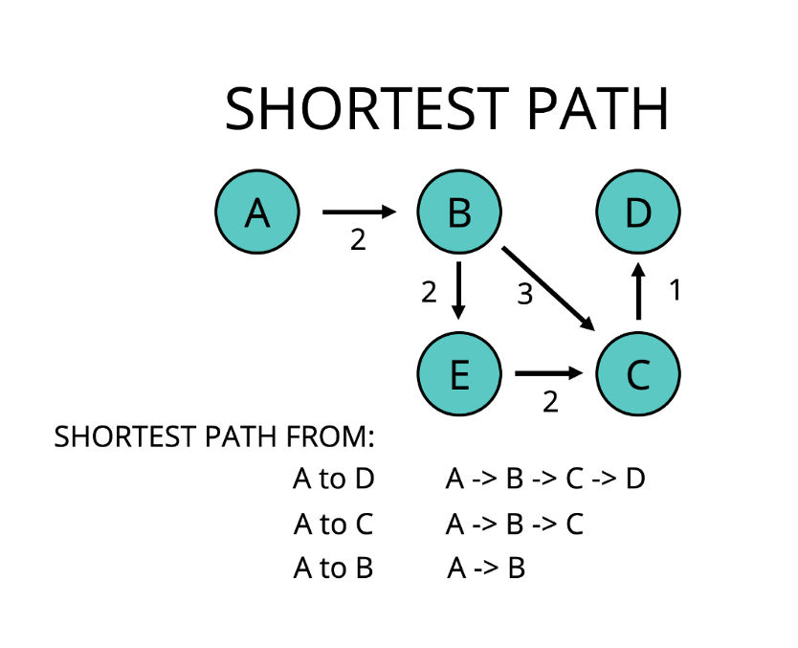
Properties of Dynamic Programming
Optimal Substructure: Optimal solution to the main problem can be constructed using the optimal solution of sub-problem
Example:
Shortest path, Knapsack

Slide 8
Properties of Dynamic Programming
Optimal Substructure: Optimal solution to the main problem can be constructed using the optimal solution of sub-problem
Example:
Shortest path, Knapsack

Slide 9
Properties of Dynamic Programming
Optimal Substructure: Optimal solution to the main problem can be constructed using the optimal solution of sub-problem
Example:
Shortest path, Knapsack

Slide 10
Memoization and Tabulation
Approaches to solve a dynamic programming problem

Slide 11
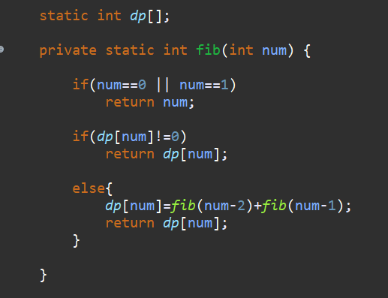
Memoization
Refers to the technique of caching and reusing previously computed results
Optimized Recursion
Store computed results in a memo
Also called a top down approach

Slide 12
Memoization
Refers to the technique of caching and reusing previously computed results
Optimized Recursion
Store computed results in a memo
Also called a top down approach
→ Declare the memo

Slide 13
Memoization
Refers to the technique of caching and reusing previously computed results
Optimized Recursion
Store computed results in a memo
Also called a top down approach
→ Declare the memo
→ Base Case

Slide 14
Memoization
Refers to the technique of caching and reusing previously computed results
Optimized Recursion
Store computed results in a memo
Also called a top down approach
→ Declare the memo
→ Base Case
→ Return the computed result which was stored

Slide 15
Memoization
Refers to the technique of caching and reusing previously computed results
Optimized Recursion
Store computed results in a memo
Also called a top down approach
→ Declare the memo
→ Base Case
→ Return the computed result which was stored
→ If the result is not computed, calculate it using the fibonacci formula and store it in the memo for future purposes

Slide 16
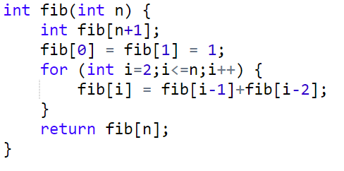
Tabulation
Solve all the related sub-problems
First fill up the table
Using the results in the table, then compute the solution to the original problem
Also called a bottom up approach

Slide 17
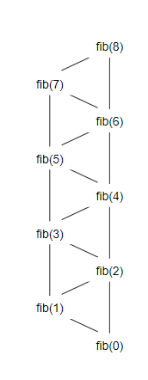
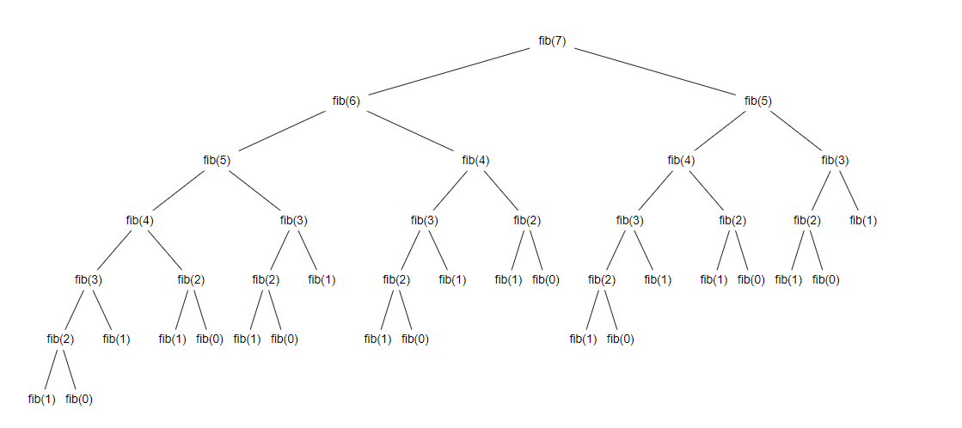
Call Tree
Plain Recursion - O(2^N)
Dynamic Programming- O(N)

Slide 18
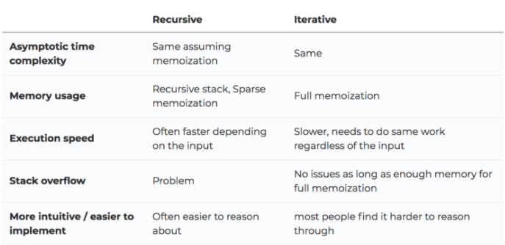
Tabulated vs Memoized version
Both store the solutions of subproblems.
In memoized, table is filled on demand
In tabulated, the memo is filled starting from the first entry

Slide 19
Live Demo:
CCC’12 - S5 Mouse Journey

Slide 20
DP Problem: Knapsack

Slide 21

Intro - Flying to Mars
In 2046, Elon Musk finally figured out how to send rich people to Mars in spaceships
But, he also wants to gain $$
They only have a limited amount of space available in the spaceship
Given a spaceship with a maximum restricted weight and people who can pay different amounts, how could he send people to Mars by maximizing his profit
Remember, a full person can only be sent. People cannot be cut in half

Slide 22
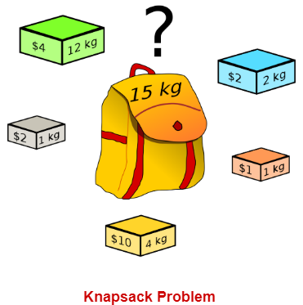
The problem
Given weights and values of n items, put these items in a knapsack of capacity W to get the maximum total value in the knapsack.
What is the maximum value you get by carrying out items which will not exceed the maximum weight?

Slide 23

Naive solution
Try all combinations of items to place it in the knapsack
0 - included, 1 - excluded
Ex. 00000, 10010, 00101 ...
Notes:
Explain using math:
Five different items
2 options for each value (include or exclude): 2^5 = 32

Slide 24
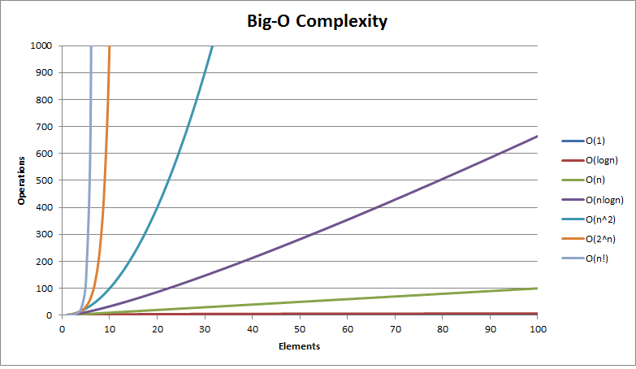
Naive solution
Try all combinations of items to place it in the knapsack
0 - included, 1 - excluded
Ex. 00000, 10010, 00101 ...
Time complexity: 2^n (exponential)
Five different items
2 options for each value (include or exclude): 2^5 = 32

Slide 25
Dynamic Programming Approach
Steps to Solve:
Create a v[n] array to represent and store the value of each individual item
Create a w[n] array to represent and store the weight of each individual item
Create a 2d array dp[][] with size - (max weight+1) x (number of items+1) to compute and store the maximized value
Notes:
Array starts at index 0, therefore initialize the data structure with size W+1, n+1

Slide 26
Dynamic Programming Solution
There will be two cases for the 0-1 knapsack. Choose the item for the maximum weight or not choose.
case 1: optimal solution does not include item i
total value is same as before
case 2: optimal solution does include item i
total value is -
value of item i + value of optimal solution for remaining capacity of knapsack and allowable items

Slide 27
Dynamic Programming Approach
Store the weights of each item
x | 0kg | 1kg | 2kg | 3kg | 4kg | 5kg | ...
Item#0
Item#1
Item#2
Item#3
Item #4
Item #5
w | v
1kg | $2
2kg | $2
12kg | $4
1kg | $1
4kg | $10
Store the values($) of each item
Notes:
Array starts at index 0, therefore initialize the data structure with size W+1, n+1

Slide 28
Dynamic Programming Approach
Store the weights of each item
x | 0kg | 1kg | 2kg | 3kg | 4kg | 5kg | ...
Item#0 | 0 | 0 | 0 | 0 | 0 | 0
Item#1 | 0
Item#2 | 0
Item#3 | 0
Item #4 | 0
Item #5 | 0
w | v
1kg | $2
2kg | $2
12kg | $4
1kg | $1
4kg | $10
Create dp[][]
which computes the maximized value
Store the values($) of each item
Notes:
Array starts at index 0, therefore initialize the data structure with size W+1, n+1

Slide 29
Dynamic Programming Approach
x | 0kg | 1kg | 2kg | 3kg | 4kg | 5kg | ...
Item#0 | 0 | 0 | 0 | 0 | 0 | 0
Item#1 | 0 | 2 | 2 | 2 | 2 | 2
Item#2 | 0
Item#3 | 0
Item #4 | 0
Item #5 | 0
w | v
1kg | $2
2kg | $2
12kg | $4
1kg | $1
4kg | $10
Break the problem into sub-problems and solve them
Notes:
Array starts at index 0, therefore initialize the data structure with size W+1, n+1

Slide 30
Dynamic Programming Approach
x | 0kg | 1kg | 2kg | 3kg | 4kg | 5kg | ...
Item#0 | 0 | 0 | 0 | 0 | 0 | 0
Item#1 | 0 | 2 | 2 | 2 | 2 | 2
Item#2 | 0 | 2 | max(0+2,2)= 2 | max(2+2,2)= 4 | max(2+2,2)= 4 | max(2+2,2)= 4
Item#3 | 0
Item #4 | 0
Item #5 | 0
w | v
1kg | $2
2kg | $2
12kg | $4
1kg | $1
4kg | $10
Current item value + best value you can get in the remaining space
Notes:
Array starts at index 0, therefore initialize the data structure with size W+1, n+1

Slide 31
Dynamic Programming Approach
x | 0kg | 1kg | 2kg | 3kg | 4kg | 5kg | ...
Item#0 | 0 | 0 | 0 | 0 | 0 | 0
Item#1 | 0 | 2 | 2 | 2 | 2 | 2
Item#2 | 0 | 2 | max(0+2,2)= 2 | max(2+2,2)= 4 | max(2+2,2)= 4 | max(2+2,2)= 4
Item#3 | 0 | 2 | 2 | 4 | 4 | 4
Item #4 | 0
Item #5 | 0
w | v
1kg | $2
2kg | $2
12kg | $4
1kg | $1
4kg | $10
Notes:
Array starts at index 0, therefore initialize the data structure with size W+1, n+1

Slide 32
Dynamic Programming Approach
x | 0kg | 1kg | 2kg | 3kg | 4kg | 5kg | ...
Item#0 | 0 | 0 | 0 | 0 | 0 | 0
Item#1 | 0 | 2 | 2 | 2 | 2 | 2
Item#2 | 0 | 2 | max(0+2,2)= 2 | max(2+2,2)= 4 | max(2+2,2)= 4 | max(2+2,2)= 4
Item#3 | 0 | 2 | 2 | 4 | 4 | 4
Item #4 | 0 | max(0+1,2)= 2 | max(2+1,2)= 3 | max(2+1,4)= 4 | max(4+1,4)= 5 | max(4+1,4)=5
Item #5 | 0
w | v
1kg | $2
2kg | $2
12kg | $4
1kg | $1
4kg | $10
Notes:
Array starts at index 0, therefore initialize the data structure with size W+1, n+1

Slide 33
Dynamic Programming Approach
x | 0kg | 1kg | 2kg | 3kg | 4kg | 5kg | ...
Item#0 | 0 | 0 | 0 | 0 | 0 | 0
Item#1 | 0 | 2 | 2 | 2 | 2 | 2
Item#2 | 0 | 2 | max(0+2,2)= 2 | max(2+2,2)= 4 | max(2+2,2)= 4 | max(2+2,2)= 4
Item#3 | 0 | 2 | 2 | 4 | 4 | 4
Item #4 | 0 | max(0+1,2)= 2 | max(2+1,2)= 3 | max(2+1,4)= 4 | max(4+1,4)= 5 | max(4+1,4)=5
Item #5 | 0 | 2 | 3 | 4 | max(10+0,5)= 10 | max(10+2,5)=12
w | v
1kg | $2
2kg | $2
12kg | $4
1kg | $1
4kg | $10
Notes:
Array starts at index 0, therefore initialize the data structure with size W+1, n+1

Slide 34
Contd. (core part of the algorithm)
Iterate through each row ‘i’ and each column ‘j’ of the array
If the weight of the item is greater than the max weight allowed, do not include it : w[i]> j
Dp [i][j] = dp[i-1] [j]
If the weight of the item is less than the max weight allowed, we choose the case with the greater value
Dp[i][j] = max (dp [i-1][j] , dp [i-1][j - w[i]] + v[i] )

Slide 35
Complexity Analysis
Since you’re looping (i) through N items and (j) through each individual weight, the time complexity is O(N*W), if there are N items and the weight is W.
The space required is O(N*W) if a 2d array is used
Optimized version can take O(W) space
Notes:
DP can be a 1D array instead of a 2D array

Slide 36
Knapsack demo
Time for some participation!

Slide 37
Challenges to try!
My email:
349932848@gapps.yrdsb.ca
Knapsack
CCC - S5 Mouse Journey
Summer Institute - Mo’ Money
DMOPC '19 Contest 2 P2
CCC '07 J5 - Keep on Truckin'

Slide 38
Resources
More problems and advanced concepts

